Slide 1



Short Software Quality Control Course 2015
Quality Assurance for Your Annuals Final Project
alfiangozali
Alfian Akbar Gozali
D3 Teknik Informatika
Telkom Applied Science School
alfian@tass.telkomuniversity.ac.id
Alfian Akbar Gozali

Slide 2
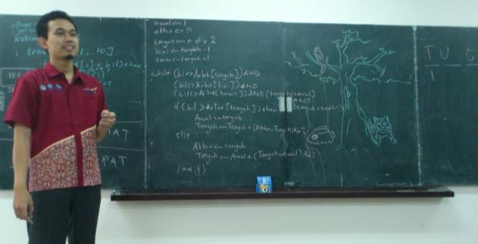

Introduction
Let me introduce myself…
4/20/2015
AAZ – Alfian Akbar Gozali
1

Slide 3



Agenda
Chapter 1
Testing Folktales
Chapter 2
Testing Facts
Chapter 3
Test Plan
4/20/2015
AAZ – Alfian Akbar Gozali
1

Slide 4
Chapter 1
Testing Folktales
4/20/2015
AAZ – Alfian Akbar Gozali
1

Slide 5
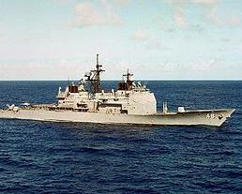
Testing Folktales
USS Yorktown, SmartShip
Crew member entered 0 in a data entry field, caused a “divide by 0” error that shut down propulsion
Dead in the water for 2hrs 45mins
4/20/2015
AAZ – Alfian Akbar Gozali
1
Notes:
Cerita Testing : devide by zero menyebabkan tenaga penggerak mati selama 2 jam 45 menit.

Slide 6

Testing Folktales
Ariane 5 Flight 501
Re-used code from Ariane 4, but took a different flight path because of different booster design
Conversation from 64bit float to 16bit signed int caused overflow (exception handler was disabled for perf reasons)
Cost: > $370 million @ 1996 prices
4/20/2015
AAZ – Alfian Akbar Gozali
1
Notes:
Cerita Testing : code mesin sebelumnya digunakan lagi tp dengan pendorong yang beda. Mengaikbatkan overflow dan biaya membengkak

Slide 7
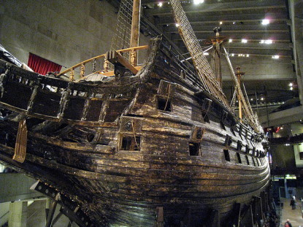
Testing Folktales
Vasa
Sank after sailing less than 1 nautical mile out of Stockholm
Specifications were faulty, failing to take into account enough ballast to keep the ship upright
Test teams revealed that it was unstable, but launch was rushed, and QA was ignored
4/20/2015
AAZ – Alfian Akbar Gozali
1
Notes:
Cerita Testing : tenggelam setelah berlayar 1 mil karena spec yang salah. Test mengungkapkan tidak stabil tapi launching terburu2

Slide 8
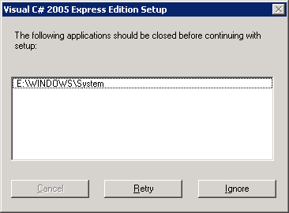
Testing Folktales
Still Remember this?
4/20/2015
AAZ – Alfian Akbar Gozali
1

Slide 9
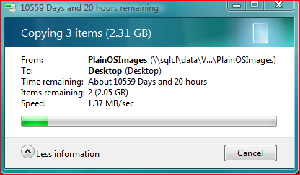
Testing Folktales
And this?
4/20/2015
AAZ – Alfian Akbar Gozali
1

Slide 10
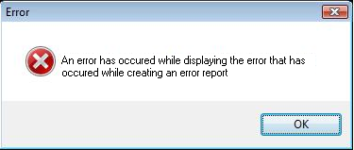
Testing Folktales
Errors..errors everywhere…
4/20/2015
AAZ – Alfian Akbar Gozali
1

Slide 11
Chapter 2
Testing Facts
4/20/2015
AAZ – Alfian Akbar Gozali
1

Slide 12




Testing Facts
Mountain Climbing
Cost of Failure
Training
Conditioning
Climbing
Training Phase
4/20/2015
AAZ – Alfian Akbar Gozali
1

Slide 13

Testing Facts
Ultimate Goal…
4/20/2015
AAZ – Alfian Akbar Gozali
1

Slide 14




Testing Facts
Software Phase
Cost of Bugs
Development
Test
Release
Software Phase
4/20/2015
AAZ – Alfian Akbar Gozali
1

Slide 15

Testing Facts
Tester Segmentation
Generalist |  |  | Specialist
Manual Testing | Some scripting Creates scripts to set up lab, create data | Strong scripting skills Some coding skills |  | Strong coding Develops automated testing procedures | Expert coding skills
70% of testing happens here
majority of test tools target here
Black Box Testing
White Box Testing
API Testing
4/20/2015
AAZ – Alfian Akbar Gozali
1

Slide 16

Testing Facts
And when tester finds a bug…
Graphic by Jeff Atwood (CodingHorror.com)
4/20/2015
AAZ – Alfian Akbar Gozali
1

Slide 17

Testing Facts
Test Area
4/20/2015
AAZ – Alfian Akbar Gozali
1

Slide 18
Chapter 3
Test Plan
4/20/2015
AAZ – Alfian Akbar Gozali
1

Slide 19
Test Plan
Already know the importance of testing?
Now, it’s the time to
build your own test plan!
<<format attached>>
4/20/2015
AAZ – Alfian Akbar Gozali
1

Slide 20
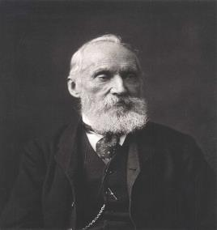
Test Plan
Lord Kelvin, 1824-1907
“…you cannot manage what you cannot measure…”
4/20/2015
AAZ – Alfian Akbar Gozali
1

Slide 21
Thank you

